Slide 1
GREEN HOUSE MONITORING SYSTEM
USING ARDUINO UNO

Slide 2
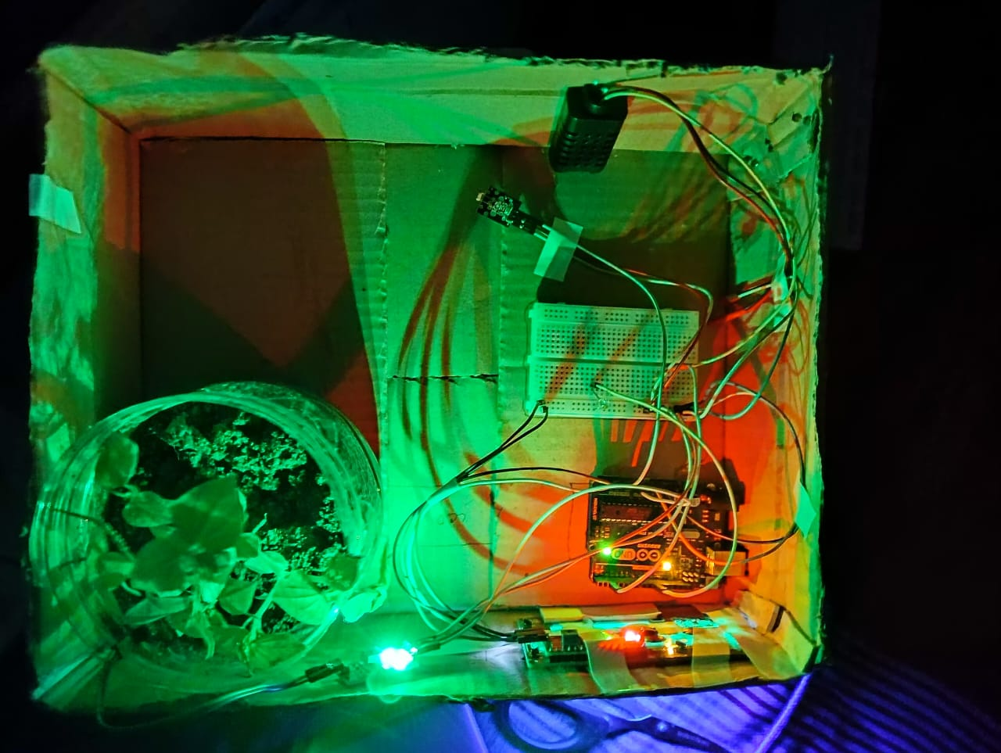
Presented By
Rakib Hasan (1801047)
Md Mahmudul Hasan (1901047)
Md. Sakibul Alam Sakib (2001032)
Fardin Ahmed Ashan (2001033)
Shimul Mahmud Khatami (2001037)

Slide 3
Overview
Introduction
Sensors and Data Acquisition
Environmental Monitoring
Irrigation and Climate Control
Data Analysis and Visualization
Block Diagram
Applications
Future Possibilities
Conclusion

Slide 4
Introduction
Smart Technology
Sensors
Ideal Growing conditions
Automatic watering
Real Time data
Digital caretaker
Efficient farming
Crop growth enhancement

Slide 5
Sensors
In the Greenhouse Monitoring System project, various sensors are employed to gather crucial environmental data for optimizing plant growth. Here's a breakdown of the sensors used and their roles in data acquisition.
Soil Moisture Sensor
Humidity sensor
Temperature sensor
Photo Resistor Sensor (KY-018)

Slide 6
Data Acquisition
The Greenhouse Monitoring System ensures that plants receive the perfect balance of water, light, humidity, and temperature, resulting in healthier and more abundant crops.
1.Sensor Readings
2.Data Processing
3.Data Interpretation
4.Decision Making
5.User Interface

Slide 7
Environmental Monitoring
Continuous tracking and analysis of various data.
Temperature
Humidity
Soil Moisture
Light Intensity

Slide 8
Irrigation
Soil Moisture-Based Irrigation
Automated Watering

Slide 9
Climate Control
Temperature and Humidity Regulation:
Shading and Light Control:

Slide 10
Data Analysis and Visualization
Temperature
Humidity
Soil moisture
Light
Real time data
Visualization
Data processing
Informed decision making
Green house condition

Slide 11
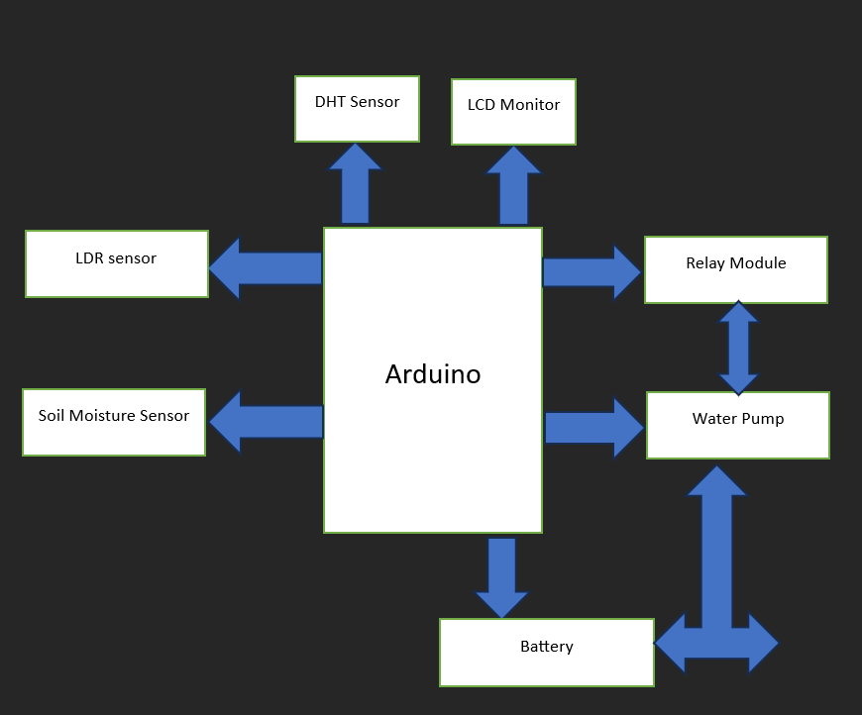
Block Diagram

Slide 12
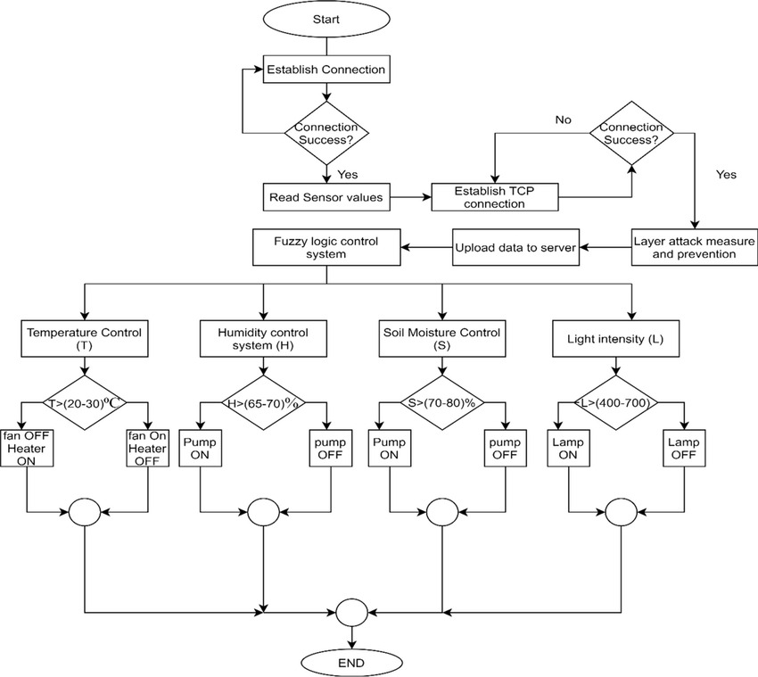
Flow Chart

Slide 13
Applications
Precision: Optimizes crop growth through precise environmental control.
Smart Farming: Enables remote monitoring and management of greenhouse operations.
Crop Research: Provides controlled environments for studying plant behavior and conducting experiments.
Urban Farming: Supports vertical and urban farming initiatives in limited spaces.
Commercial Greenhouses: Increases crop yields, improves quality, and reduces resource wastage for higher profits.
Sustainable Agriculture: Promotes resource conservation, including water and energy, contributing to eco-friendly farming practices.
Research and Development: Supports agricultural research, leading to advancements in greenhouse technologies and farming practices.

Slide 14
Future Possibilities
AI Integration: Implementing artificial intelligence for predictive analytics and automated crop management can significantly improve efficiency and yield.
IoT Connectivity: Expanding IoT integration can enable seamless real-time data sharing, enhancing overall system performance.
Mobile Apps: Developing user-friendly mobile applications makes greenhouse monitoring and control accessible and convenient for farmers.
Renewable Energy: Incorporating renewable energy sources like solar power can reduce operational costs and make the system more sustainable.
Blockchain Security: Utilizing blockchain technology ensures data security and transparency, adding value to the supply chain and building consumer trust.

Slide 15
Conclusion
Agriculture revolution
Advanced technologies
Crop quality enhancement
Sustainable farming
Global food security

Slide 16
Thank you

